Slide 1
C1 - NSG CODERS
LANGUAGE ASSESSMENT TOOL
TEAM MEMBERS :
SANKAR ADITYA
NOEL CYRIAC
GAUTHAMAN S

Slide 2
WIREFRAME - 1 DESKTOP VIEW
THE FIRST WIREFRAME SHOWS THE VIEW OF USER ACCESSING THE WEBSITE FROM A PC/LAPTOP.
REST OF THE WIREFRAMES SHOW THE VIEW OF USER ACCESSING THE APP FROM AN ANDROID/IOS DEVICE.
THE FUNCTIONALITIES IN BOTH THE PLATFORMS REMAINS THE SAME

Slide 3
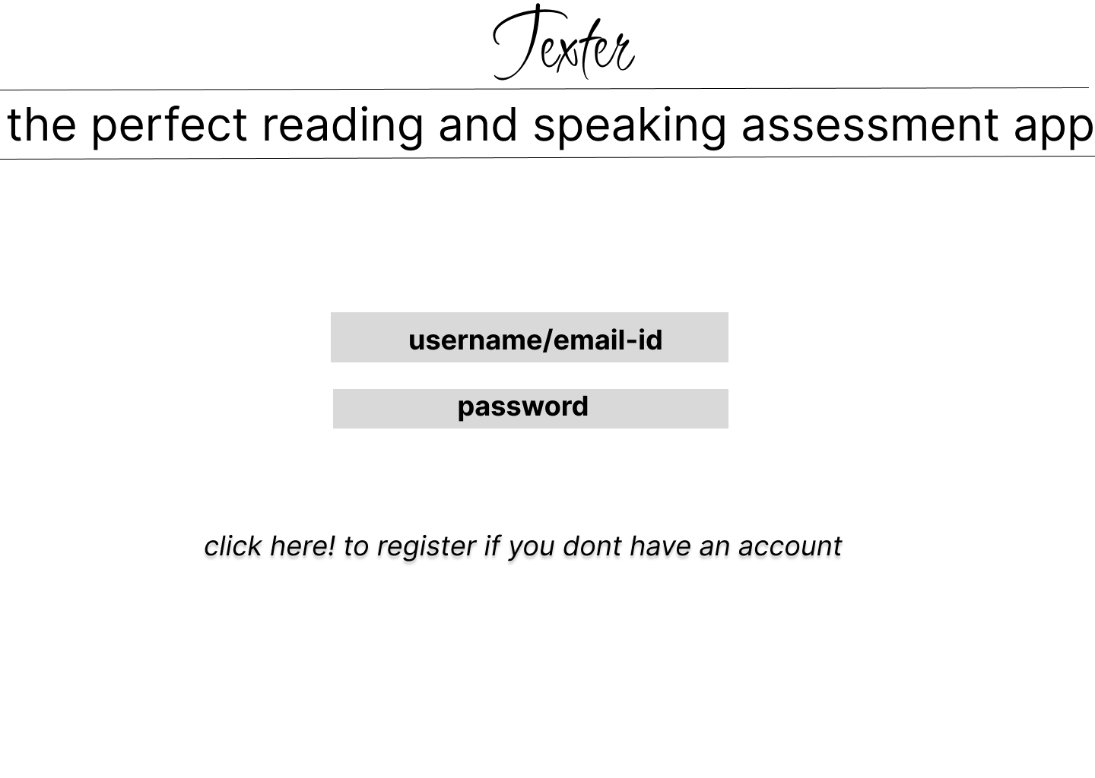

Slide 4
WIREFRAME - 2 APP VIEW LOGIN SCREEN
EXISTING USERS CAN ENTER THEIR USERNAME/EMAIL , PASSWORD AND PRESS ENTER TO LOG IN .
NEW USERS CAN PRESS REGISTER

Slide 5
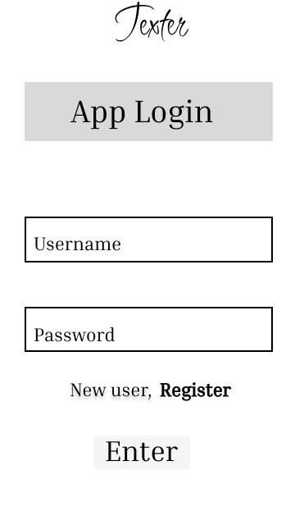

Slide 6
WIREFRAME - 3 REGISTER
ENTER NAME AND CLASS FOR STUDENT
ENTER NAME FOR TEACHER AND SELECT CLASS AS TEACHER
TYPE USERNAME/EMAIL AND PASSWORD

Slide 7
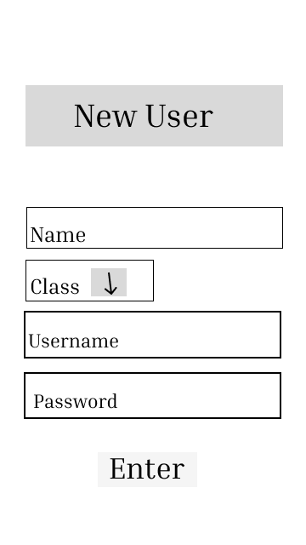

Slide 8
WIREFRAME - 4 STUDENT / TEACHER
WHEN REGISTERING , THE USER IS GIVEN THE CHOICE OF EITHER SELECTING STUDENT OR TEACHER
TEACHERS CAN VIEW THE SCORES AND PROGRESS OF THE STUDENTS UNDER THEIR SUPERVISION
USER IS GIVEN THE CHOICE OF SELECTING THE LANGUAGE HERE

Slide 9
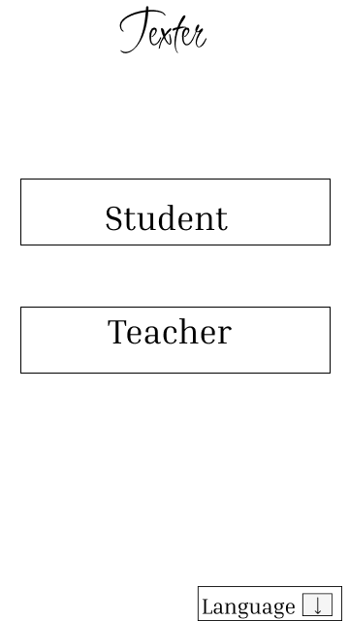

Slide 10
WIREFRAME - 5 TEACHER HOMEPAGE
USE LINKED PROFILES TO SEE DATA AND SCORES OF STUDENTS
CLICK ON ADD NEW PROFILE TO ADMIT A STUDENT

Slide 11
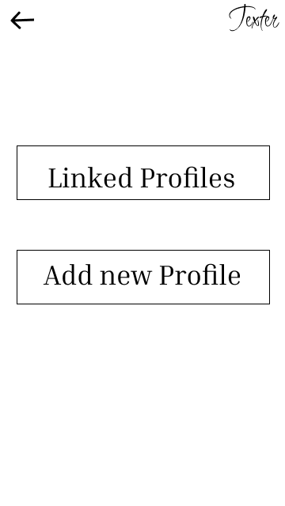

Slide 12
WIREFRAME - 6 ADD STUDENT
TEACHER NEEDS TO ENTER THE STUDENT USERNAME/EMAIL AND PASSWORD TO ADMIT THEM
THE DATA OF THE NEW STUDENTS WILL BE VISIBLE IN LINKED PROFILES

Slide 13
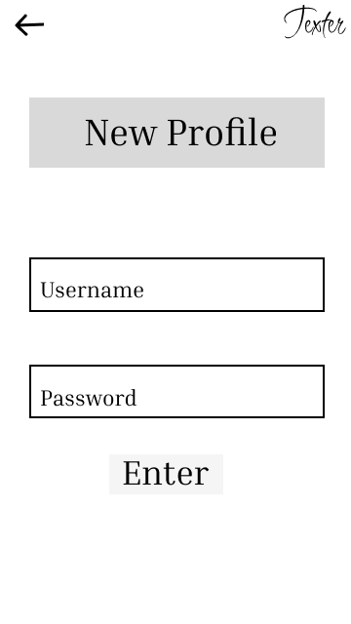

Slide 14
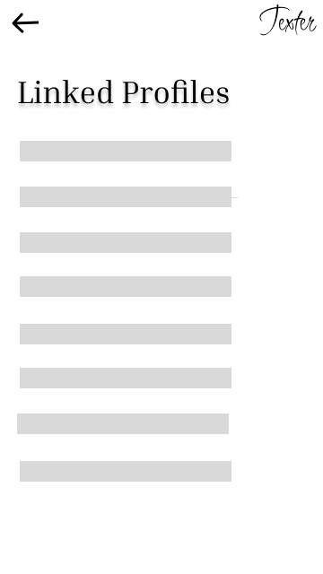

Slide 15
WIREFRAME - 7 STUDENT HOME PAGE
CONTAINS THE DETAILS, PROGRESS AND THE NEXT PENDING TASK OF THE USER.
INCLUDES DIFFERENT SECTIONS OF LEARNING LIKE READING COMPREHENSION , GRAMMAR , WRITING ETC

Slide 16
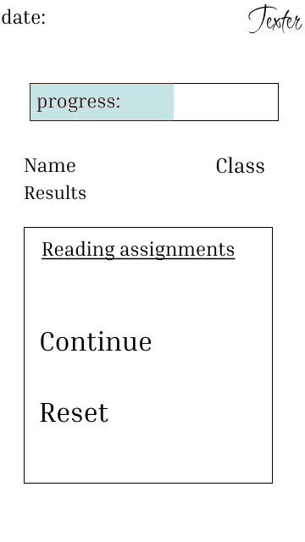

Slide 17
WIREFRAME - 8 TESTS
CONTAINS ALL THE TESTS UNDER THE PARTICULAR SECTION FOR EXAMPLE : READING COMPREHENSION

Slide 18
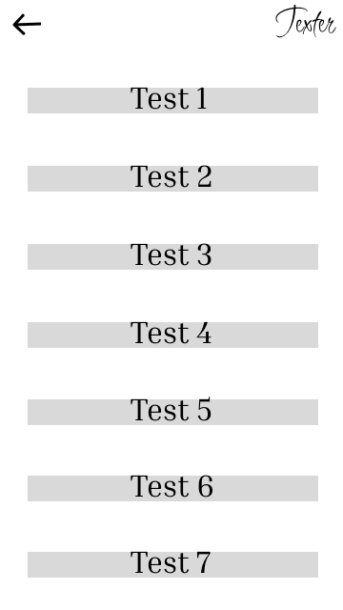

Slide 19
WIREFRAME - 9 TEST PREVIEW
THE INSTRUCTIONS AND TIME LIMIT FOR THE TEST IN DISPLAYED
CLICK ON START TEST TO BEGIN

Slide 20
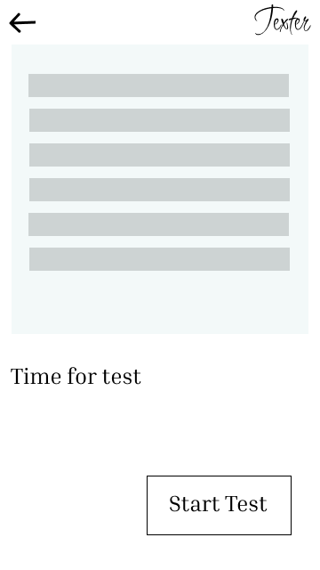

Slide 21
WIREFRAME - 10 TEST
ONGOING TEST SCREEN
REMAINING TIME IS DISPLAYED
FOR EXAMPLE IN READING COMPREHENSION SECTION , THE USER READS THE GIVEN PARAGRAPH IN THE SPECIFIED TIME

Slide 22
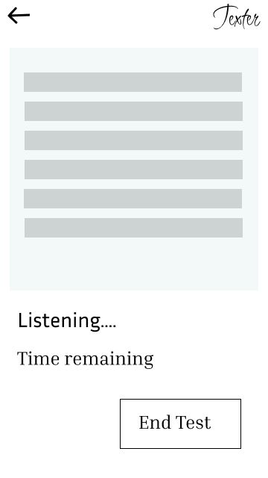

Slide 23
WIREFRAME - 11 TEST ANALYSIS
RESULTS OF THE TEST IS DISPLAYED TO THE USER
RESULT ANALYSIS INCLUDES PARAMETERS LIKE ACCURACY , GRAMMAR , SPEED , COMPREHENSION , ACCENT ETC
DIFFERENT SECTIONS USE DIFFERENT PARAMETERS TO ANALYSE RESULTS.

Slide 24
